Slide 1
Search Algorithms
Sequential Search (Linear Search)
Binary Search

Slide 2
Sequential Search
A sequential search of a list/array begins at the beginning of the list/array and continues until the item is found or the entire list/array has been searched

Slide 3
Sequential search
The sequential search is used whenever the list is not ordered.

Slide 4
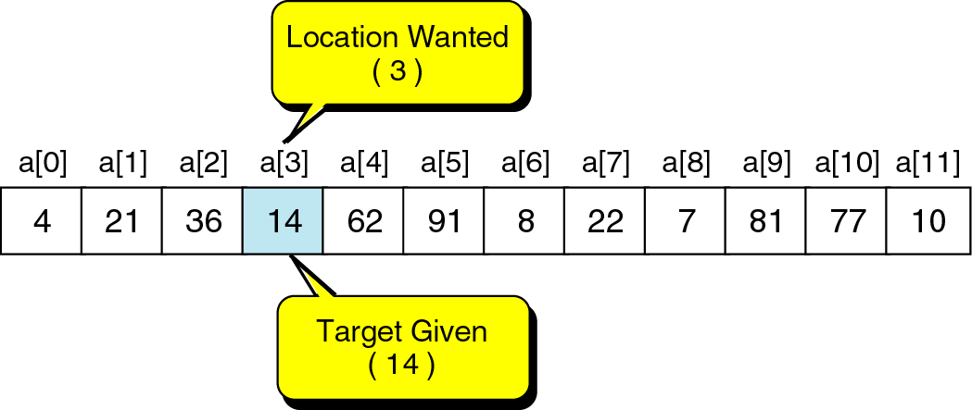
Searching
The process used to find the location of a target among a list of objects.
e.g., where is 14?

Slide 5
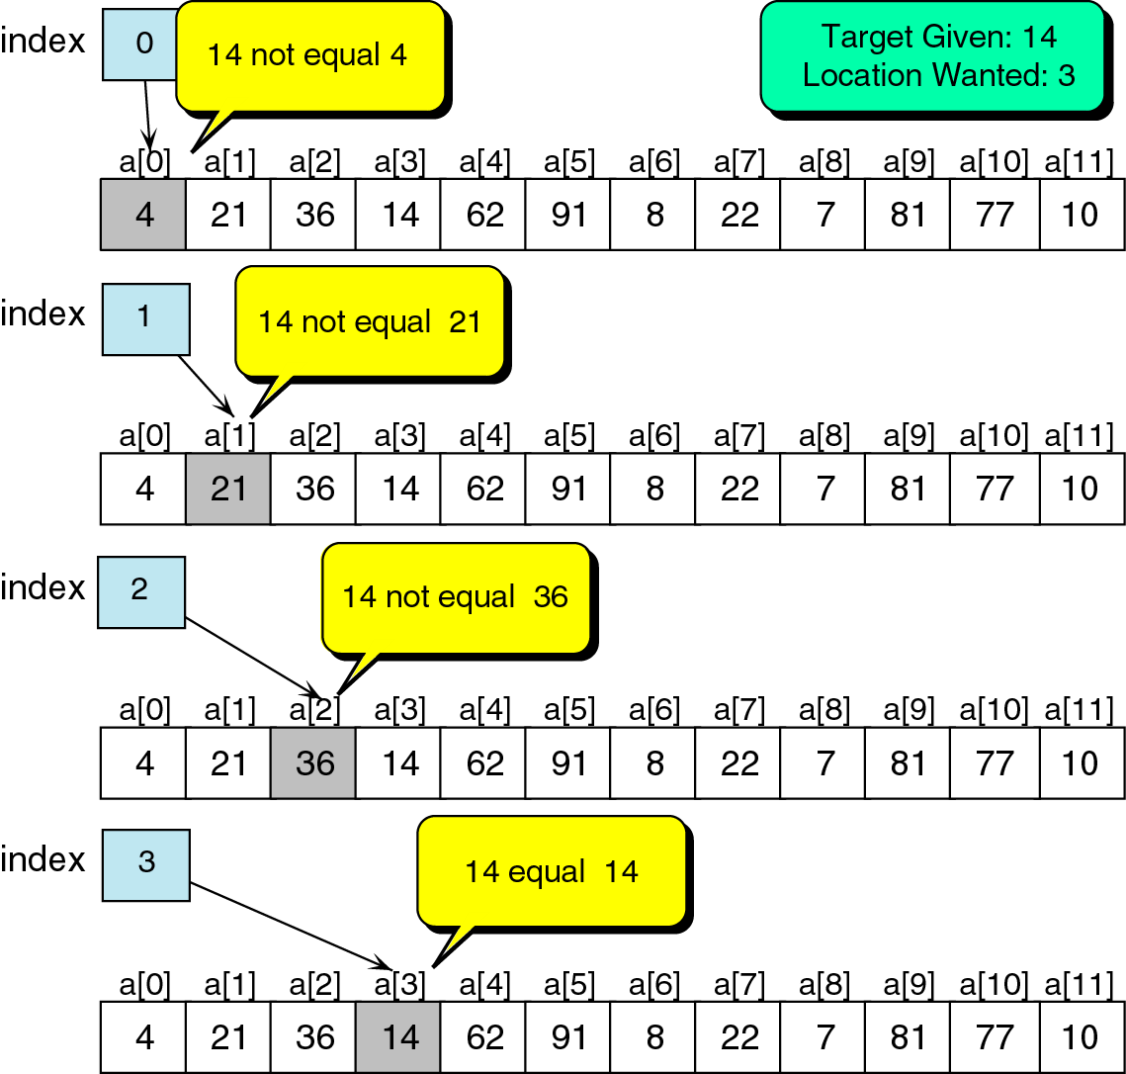
Successful search of an unordered list

Slide 6
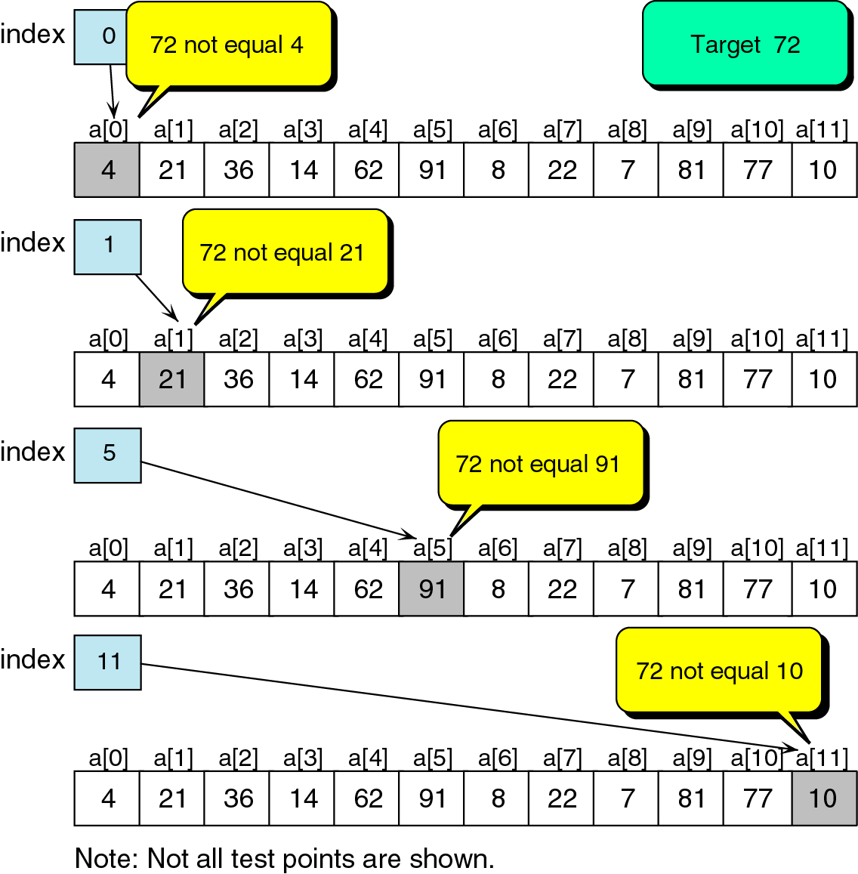
Unsuccessful search in unordered list

Slide 7
Sequential Search
int LinSearch(int x[ ], int n, int item){
for(int i=0;i<n;i++){
if(x[i]==item) return i;
else return -1;
}
}

Slide 8
Search Algorithms

Slide 9
Linear Search Related Problems
Given an array and a target element x, find the first occurrence of x and return its 0-based index. Return -1 if not found.
https://www.hackerearth.com/problem/algorithm/linear-search-2/
Counting Occurrences: Instead of just finding the first instance, write a function that counts how many times the target element appears in the array.
Searching in an Array of Objects: Implement a linear search to find an object within an array based on a specific property value (e.g., searching for a user by their username field).

Slide 10
Linear Search Related Problems
Finding Duplicate Entries: Use the principles of linear search to iterate through a list and identify all duplicate elements.
Recursive Linear Search: Implement the algorithm using recursion and analyze the differences in space and time complexity compared to the iterative approach.
Largest/Second Largest Element: Problems like finding the largest or second largest element in an array can be solved by traversing the array linearly.
All occurrences of substring in string.

Slide 11
Binary Search O(log2 n)
A binary search looks for an item in a list using a divide-and-conquer strategy

Slide 12
Binary Search
  Binary search algorithm assumes that the items in the array being searched are sorted
  The algorithm begins at the middle of the array in a binary search
  If the item for which we are searching is less than the item in the middle, we know that the item won’t be in the second half of the array
  Once again we examine the “middle” element
  The process continues with each comparison cutting in half the portion of the array where the item might be

Slide 13

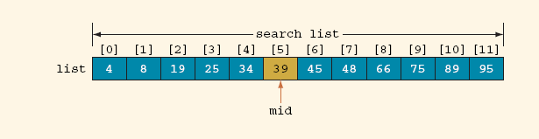
Binary Search Algorithm (Cont’d)
Determine whether 75 is in the list
Array list with twelve (12) elements
Search list, list[0] … list[11]

Slide 14
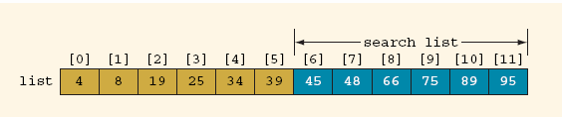
Binary Search Algorithm (Cont’d)
Search list, list[6] … list[11]

Slide 15
Binary Search: middle element
left + right
mid =
2

Slide 16
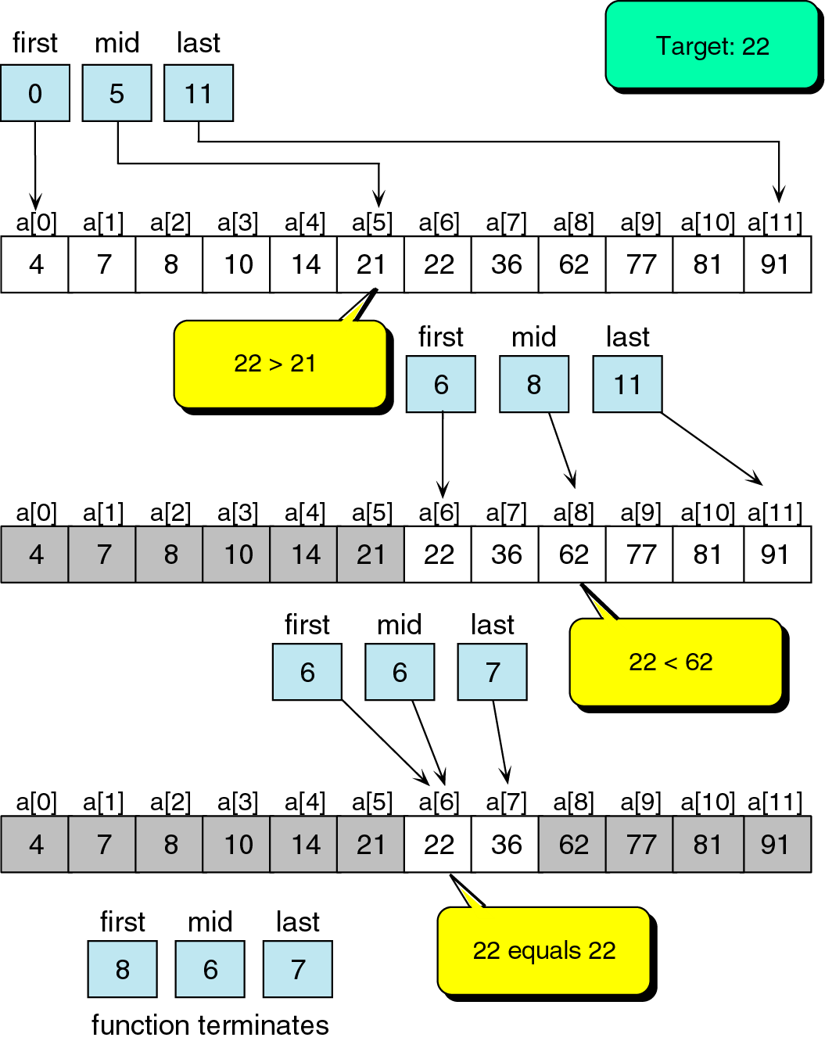
Binary search example

Slide 17
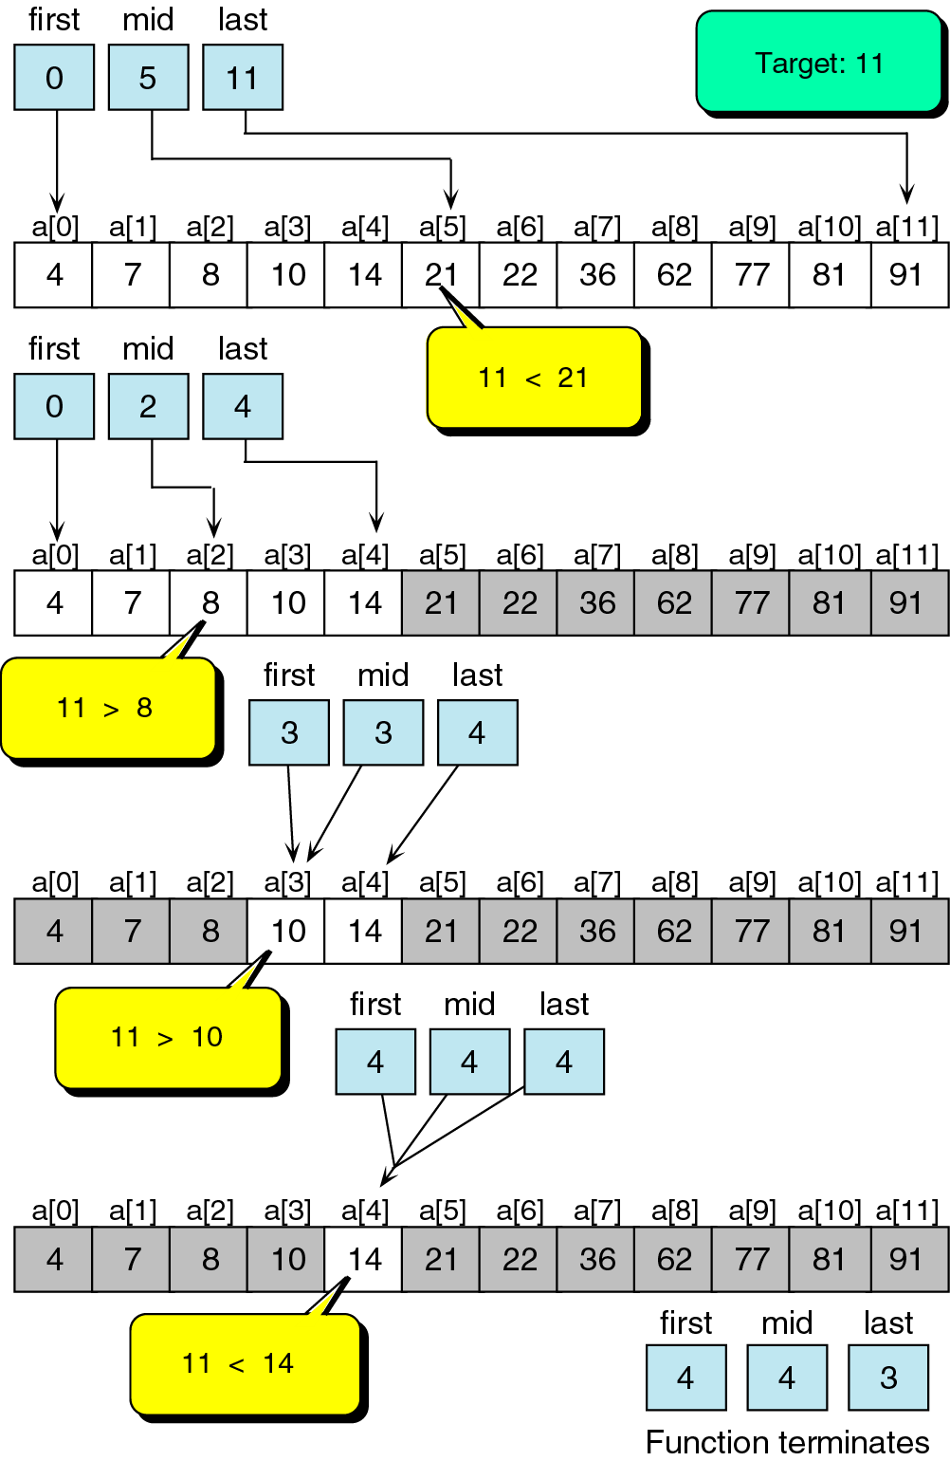
Unsuccessful binary search example

Slide 18
Binary Search
boolean BinSearch(int list[ ], int n, int item, int index){
int left=0; int right=n-1; int mid;
while(left<=right){
mid=(left+right)/2;
if(item> list [mid])
{ left=mid+1; }
else if(item< list [mid])
{right=mid-1;}
else{
Item= list [mid];
index=mid;
return true;
}
}// while
return false; }

Slide 19
Binary Search

Slide 20
Binary Search Related Problems
Binary Search (basic problem): https://leetcode.com/problems/binary-search/submissions/1921273841/
First and Last Positions in a Sorted Array: Find the starting and ending index of a given target value in an array that may contain duplicates.
Count Occurrences: Count the total occurrences of a number in a sorted array with duplicates.
Find the Insert Position: Determine the index where a target value would be inserted to maintain the array's sorted order. Practice on LeetCode.
Square Root of an Integer: Calculate the floor of the square root of a non-negative integer without using a built-in power function, by applying binary search on the potential range of answers.

Slide 21
Binary Search Related Problems
Search in a Rotated Sorted Array: Find an element in a sorted array that has been rotated at some pivot point (e.g., [4, 5, 6, 7, 0, 1, 2]).
Minimum in a Rotated Sorted Array: Find the minimum element in a sorted rotated array.
Find Peak Element: Locate a peak element in an array (an element greater than its neighbors).
Search in a 2D Matrix: Efficiently search for a value in a 2D matrix where each row and column is sorted.
Aggressive Cows / Painter Partition Problem / Book Allocation: Classic problems that use binary search on the answer (e.g., the minimum possible largest sum or the maximum possible minimum distance) to find an optimal solution.
Kth Element of Two Sorted Arrays: Find the k-th smallest element from two already sorted arrays efficiently.
Median of Two Sorted Arrays: Find the median of two sorted arrays of different sizes in logarithmic time.

